Slide 1
Stevens Creek Project Relicensing
Public Outreach Meetings
November 2018

Slide 2
Meeting Agenda
Introductions
Goal of Public Outreach
Project Overview
Federal Energy Regulatory Commission (FERC) Relicensing Process
Open Discussion Regarding Project-related Issues
Notes:
Define FERC and discuss their authority

Slide 3
Goal of Today’s Public Outreach Meetings
The goal of relicensing public outreach is to provide a relaxed atmosphere in which to discuss potential project issues with interested stakeholders

Slide 4
Goal of Today’s Public Outreach Meetings
Understand the hydroelectric project
Understand the FERC relicensing process
Begin to define and record hydroelectric project-related issues
Begin to understand the viewpoints of other stakeholders and agencies
Start to establish public involvement in the process and various environmental resource groups (RCG’s).
Notes:
More specifically
Make sure I define RCG

Slide 5

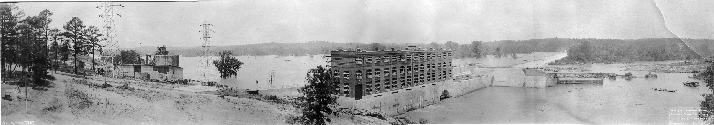
Stevens Creek Hydroelectric Project
FERC Project No. 2535 – GA,SC
November 29, 2018
Notes:
Finished construction in 1914 – photo dated June 1914
Geographical location, area included in the “Project”, little bit on the operations and identify the recreation area we maintain/support

Slide 6
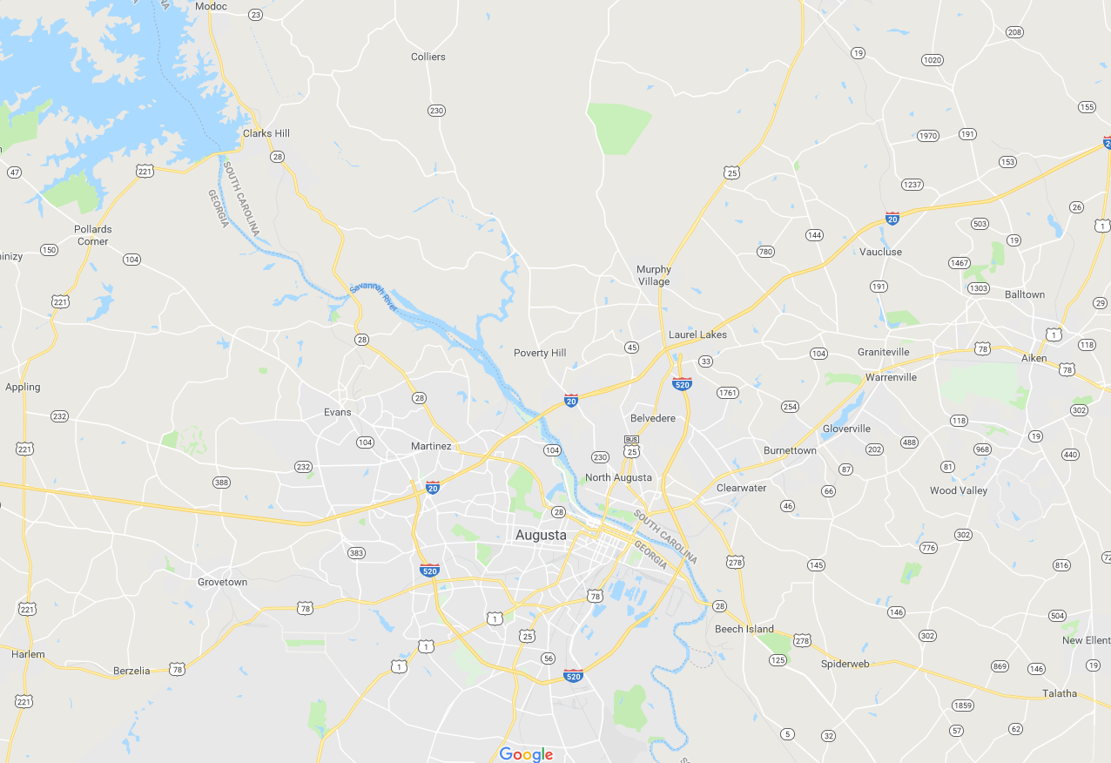
Stevens Creek Project location
Stevens Creek plant and dam
Notes:
Approx. 13 miles down stream of JST (or Clarks Hill) – 1 mile upstream of Augusta Diversion dam and the headgates of the canal

Slide 7
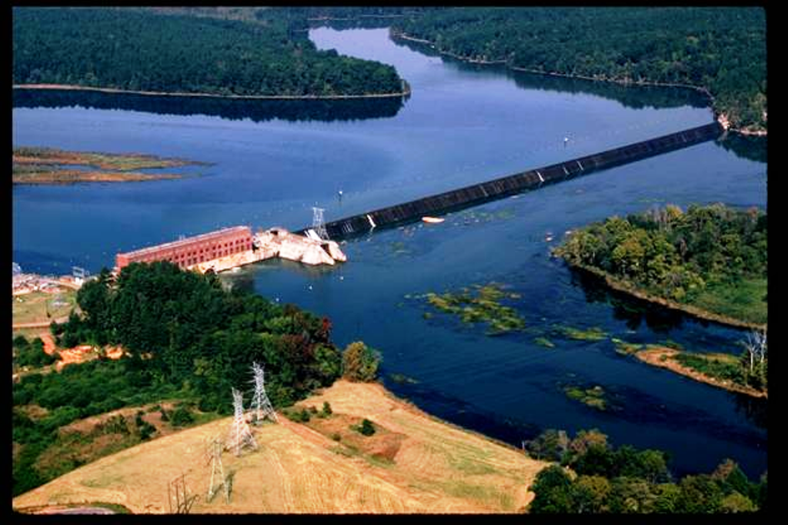
Notes:
Dam approx. 30 ft in height …. Thurmond dam 200 ft at highest point above the river bed

Slide 8
Notes:
PBL is based on elevation. PBL shows what lands are within the project boundary. Includes lands in Edgefield and McCormick in SC and Columbia Co. in GA.

Slide 13
Operations
The current license states:
Reregulate releases from Thurmond Dam
Minimize pool fluctuations
Maintain reservoir between 183.0 and 187.5 NGVD
Operating Plan developed to:
Identify minimum flow
Procedures for conditions when minimum flow may not be provided
Notes:
Reregulate JST….Maintain reservoir….have an Operating plan we work to…

Slide 14
What does “reregulation” mean?
Stevens Creek stores water when JST generates…
… and releases from storage when JST is offline
Stevens Creek outflow ranges from 3,000 to 6,000 CFS, much more constant than JST
JST outflow ranges from 0 to 20,000 CFS or more
Daily average flow is almost the same for both JST and Stevens Creek
Notes:
Thurmond operates as a peaking plant, Peaking power is produced during periods of the day when demand for electricity is highest—generally in the afternoon and early evening. The Stevens Creek Dam, on the other hand, holds a steady release rate that averages out over the day to roughly the same amount as Thurmond’s daily average release rate. JST has a generating capacity of 364 MW, Stevens Creek approx. 17 MW
Stevens Creek is not peaking plant, it support base load for the SCE&G system

Slide 15
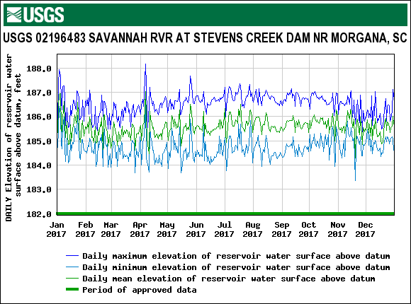
Stevens Creek reservoir
Notes:
Generally in the 2.5 ft – 3 ft range

Slide 16
Recreation
Stevens Creek Site – parking area, boat ramp, picnic tables, restroom
Chota Drive Site – parking area, paths with bank fishing access, canoe launch area
Mims Site – currently undeveloped
Fury’s Ferry Site – parking area, boat ramp, picnic tables, primitive camping area
Riverside Park – on Betty’s Branch, parking area fishing pier, boat ramp and dock
Notes:
Several in Sumter National Forest

Slide 18
Recreation

Slide 20
Shoreline management
US Army Corps of Engineers permits docks and shoreline maintenance between Thurmond dam and Stevens Creek dam.

Slide 21
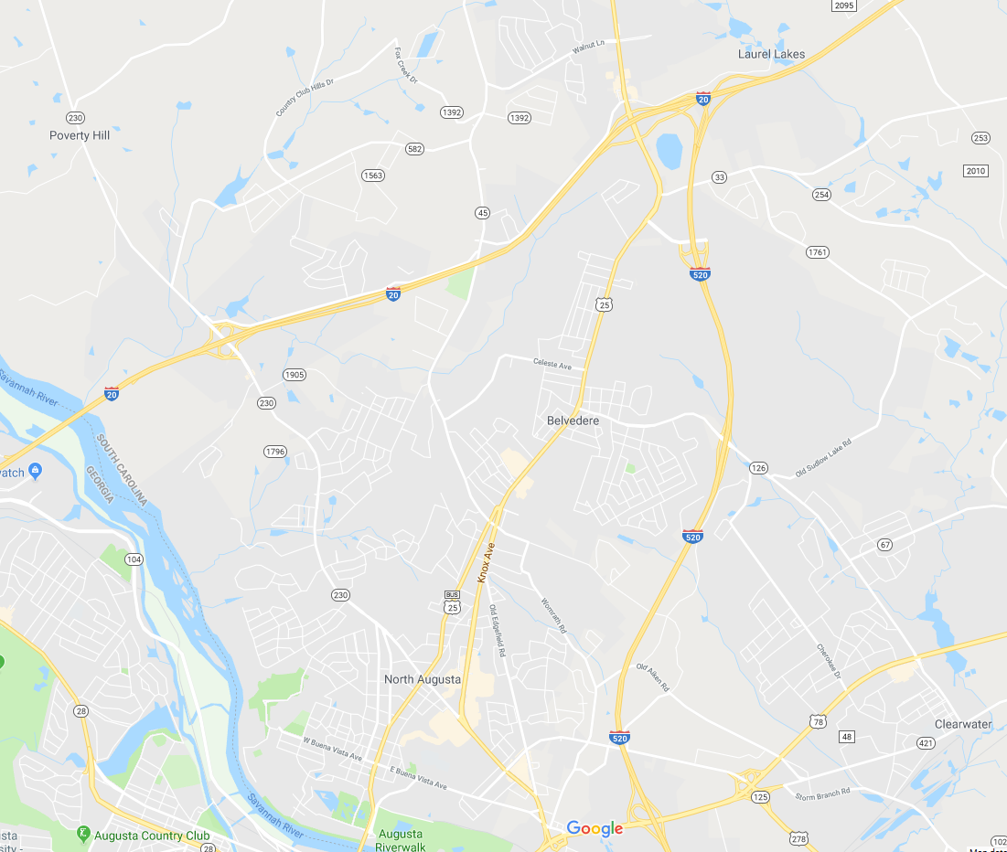
Relicensing meetings
SCE&G Misty Lake Clubhouse
1280 Ascauga Lake Road
North Augusta, SC 29841
Misty Lake Clubhouse

Slide 22
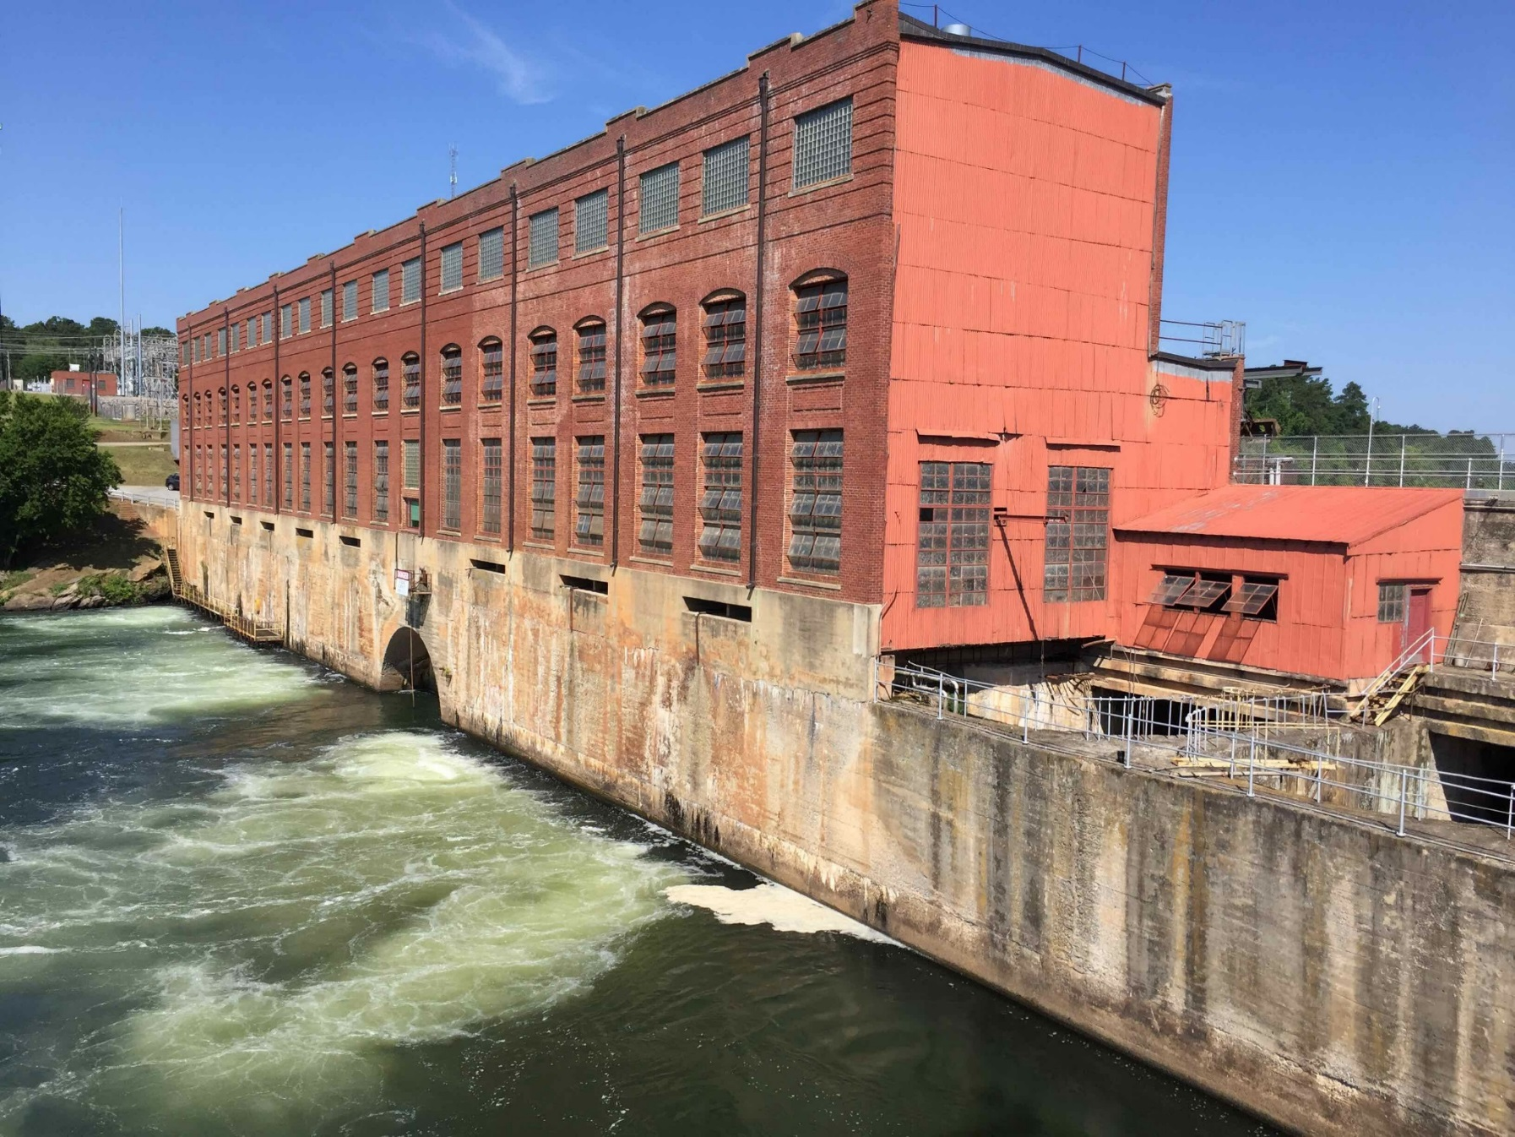

Slide 23
What Is A Relicensing?
Non-federal hydropower projects are typically required to receive a permit (i.e. license) to operate from FERC.
Typically 40-50 year term of license.
Required to start relicensing at least 5 years before existing license expires.
Licensing/Relicensing process requires environmental review per the National Environmental Policy Act (“NEPA Review”).
Relicensing includes participation of state and federal resource agencies, non-governmental organizations, and interested public.
Notes:
Non federal – means not owned by the USACE, TVA, etc.
Discuss that relicensing occurs every 30 to 50 year. 40 year new FERC standard.

Slide 24
Big Picture – Relicensing Goals
Last FERC license issued in 1995; expires 10/31/25
Complete an Enhanced Traditional Licensing Process that encourages cooperative resolution of the issues.
Develop a complete license application that does the following:
  Satisfies FERC’s regulations
  Satisfies agencies’ requirements
  Responds to and addresses public concerns
Retain operational flexibility to respond to upstream conditions.
Develop a Comprehensive Settlement Agreement
Notes:
We will discuss the TLP more on the next slide

Slide 25
FERC Relicensing Process
Proposing to use FERC’s Traditional Licensing Process (TLP) with Enhanced Stakeholder Involvement
Why TLP?
  Encourages issue resolution at the local level.
  Proven success at other projects
Notes:
Encourage issue resolution (overall settlement of issues prior to filing the license application with FERC).
Promote decision making and issue resolution at local level.
Proven success in bringing parties to agreeable resolution

Slide 26
TLP Timeline
First Stage (late 2018 through mid-2020)
  Preliminary Issues Scoping
  Issuance of Pre-Application Document (PAD) and first official relicensing meeting (Joint Agency Meeting)

Slide 27
TLP Timeline (cont.)
Second Stage (Late 2020- mid 2023)
  Environmental resource studies
  Draft License Application (DLA)
Third Stage (Mid 2023-2025)
  Final License Application
Notes:
Second Stage (Late 2020- mid 2023)
Environmental Resource Studies
Draft License Application (DLA) for agency/stakeholder review and comment
Third Stage (Mid 2023-2025)
Final License Application filed with FERC. Copies sent to agencies and interested stakeholders

Slide 28
Potential Agencies and Stakeholders
Federal: NMFS, USACE, USFWS, USFS
NGO: American Rivers, American Whitewater, Riverkeeper
South Carolina
Georgia
  SC DHEC
  SC DNR
  Edgefield County Water & Sewer Auth.
  Edgefield Planning Commission
  SC Dept. Of Archives and History
  Georgia DNR – Environmental Protection Division (401)
  Georgia DNR
  City of Augusta
  Georgia Forestry Commission
  Georgia Geologic Survey
  Georgia Historic Preservation Division

Slide 29
What can you expect?
Stakeholder education on hydropower and hydro licensing
Resource-specific working group meetings.
Public update meetings.
Developing and enhancing relationships between SCE&G, agencies, NGO’s and the public.
The use of electronic filing and document transmittal (website, e-filing, email, etc.).

Slide 30
Resource Conservation Groups
Fish, Wildlife and Water Quality
Lake, Land and Recreation Management
Project Operations
*Cultural resources will be evaluated under consultation guidelines as defined by Section 106 of the Historic Preservation Act
Notes:
These groups may be further broken into Technical Working Committees - describe

Slide 31
What is expected of participants?
Timely submittal of comments
Courteous and timely attendance at meetings
Focus on understanding and resolving issues
Use as much existing data as possible
Develop study scopes and information pertinent to Project operation and impacts (“project nexus”)
Be mindful of overall relicensing and study costs

Slide 32
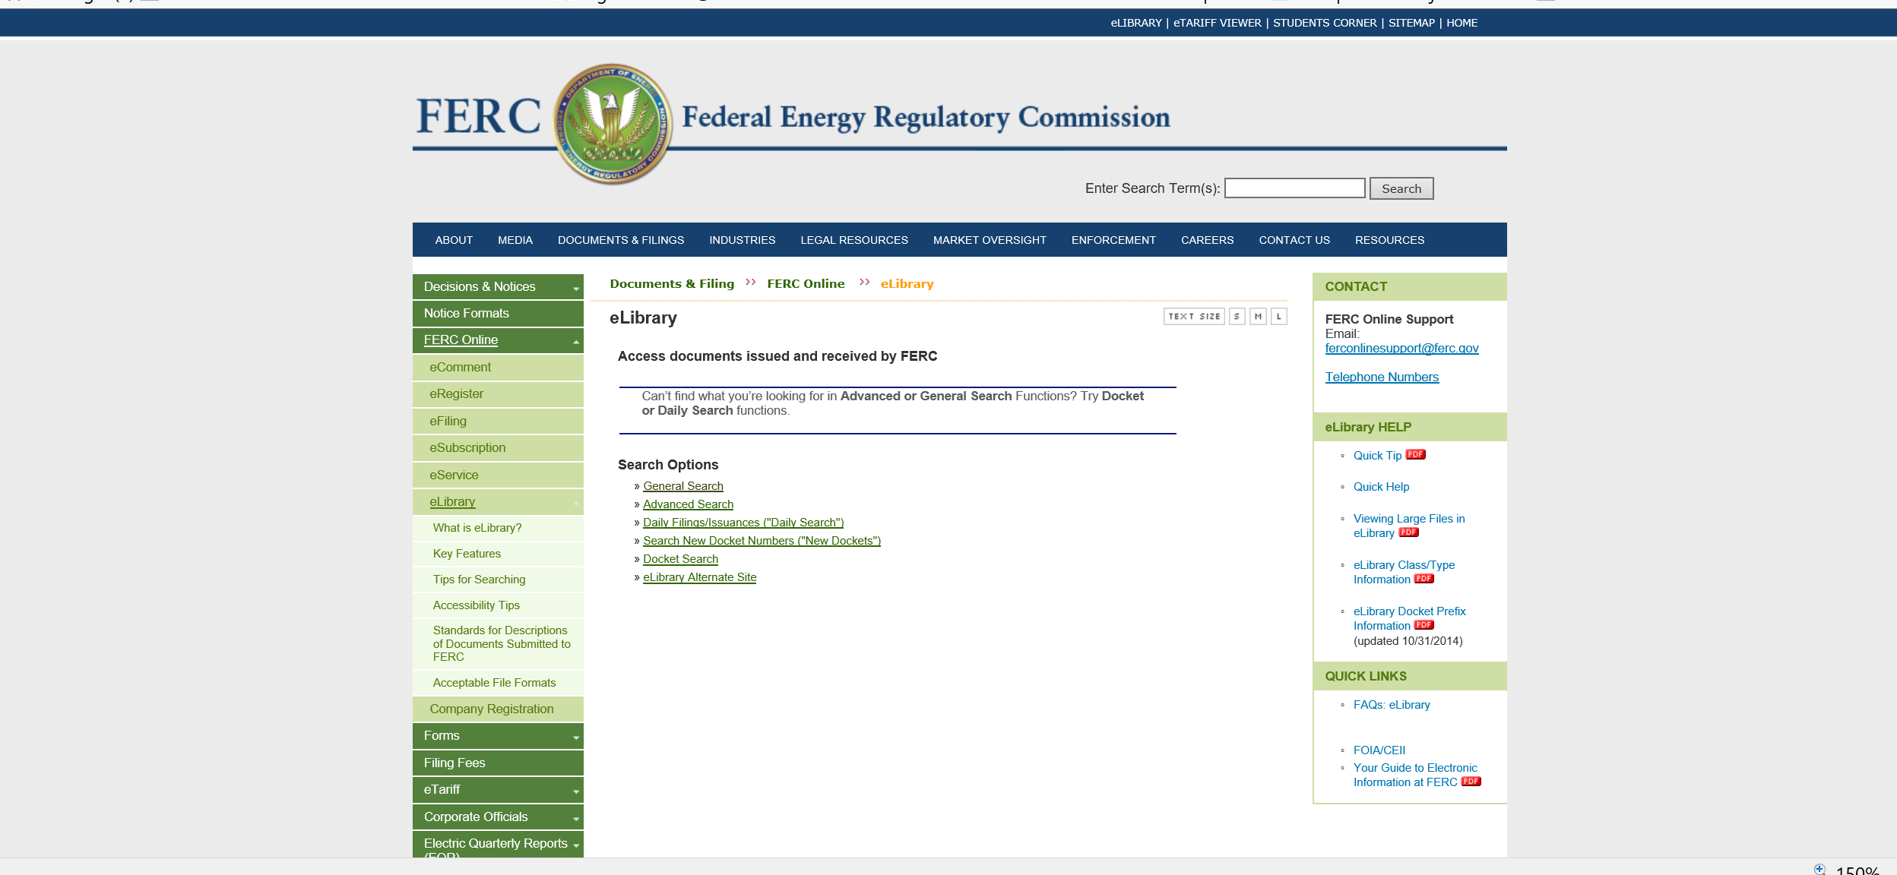
Project Number and the FERC E-Library
FERC Project Number – “P-2535”
www.ferc.gov (elibrary at top right corner)

Slide 33
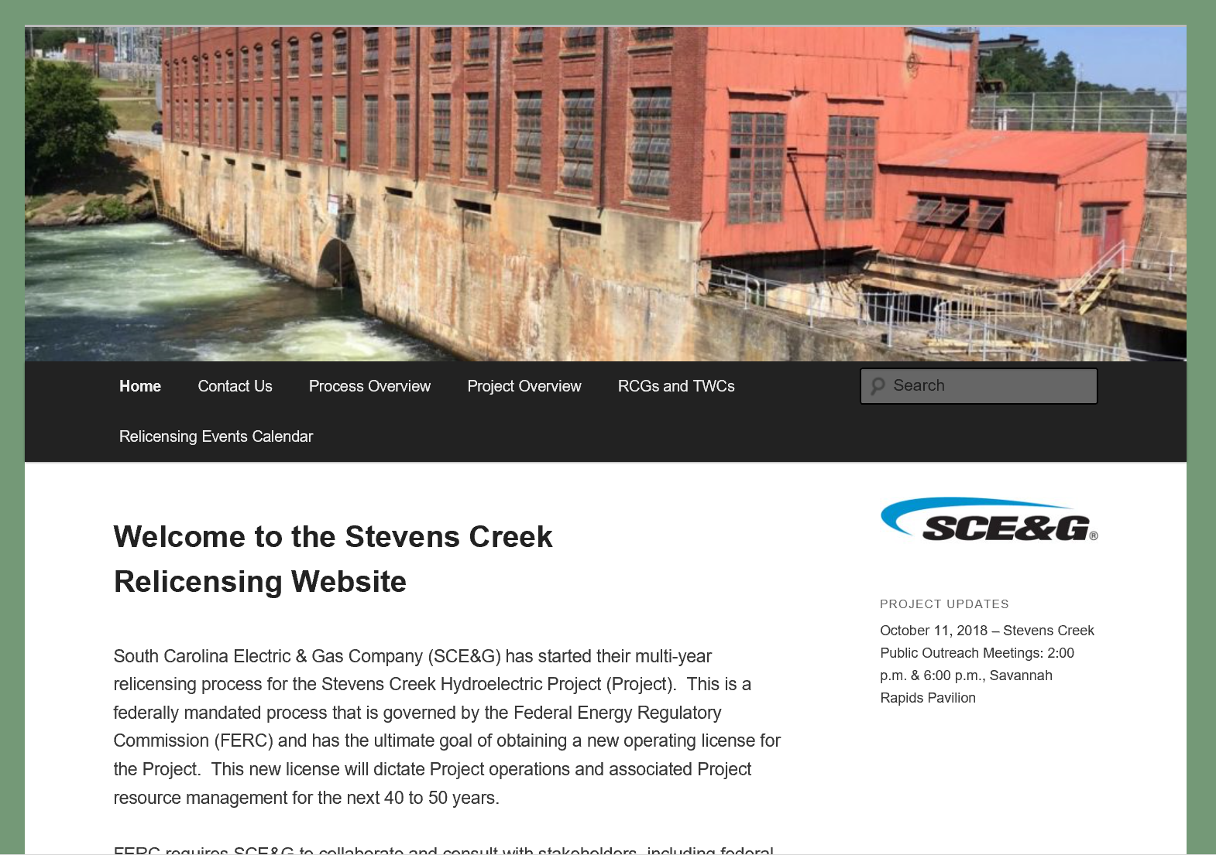
www.stevenscreekrelicense.com
Notes:
Repository for all documentation including:
FERC Relicensing Library
RCG participant information
Meeting dates and summaries
Presentations
Study Plans and Reports
Milestone documents (i.e. PAD)
Schedules and milestone dates

Slide 34
If you are interested in becoming involved…
RCG sign-up sheets in the back of the room
Sign up to be on the Project email list

Slide 35
Questions?

Slide 36
